Slide 1

DriverPass System Analysis
Eric Wallace
Notes:
[No speaker notes required for this slide.]

Slide 2

System Requirements
Application will be hosted on cloud platform.
Application will increase security by requiring MFA to login in to the system.
Application shall have reporting capabilities.
Application shall limit user access based on the role assigned to them.
Notes:
The application will be hosted in the cloud by a cloud platform provider, this will eliminate the need for the for the client to install server updates or maintain the hardware. To login to the system, it will require the user to provide a second form of authentication. This will increase security and reduce the risk of a DriverPass database breach. Non-functional requirements are requirements that the system will fulfill or actions the system will perform. The client requested some form of creating reports on the system so reporting will be implemented into the system. The second non-functional requirement is that the application limit users based on the role assigned to them, this is another request by the client.

Slide 3
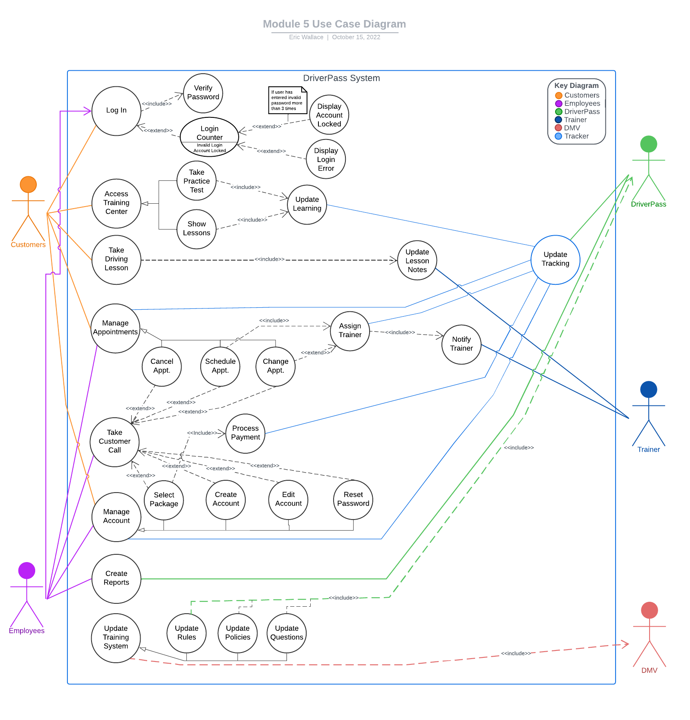
Use Case Diagram
Notes:
The users involved in this diagram are customers, employees, the DMV, trainers and the DriverPass system. The scenarios shown in the diagram were gathered from the requirements set by the customer, the first scenario is the login, employees and customers utilize this use case. If users enter a correct password they will be logged in and access their dashboard, incorrect and they will receive and error message. Three incorrect passwords and the account is locked. The second is accessing the training center in which the user can participate in learning and take practice tests.
The next is taking the driving lesson, in this scenario the customer will take the driving lesson and the trainer will update notes on the lession. After that is the scenario where a customer will interact with appointments, through the portal he can schedule, cancel and change appointments, when an appointment is created or changed the trainer that is assigned to the lesson is notified which is something the client requested.
In order for a new customer to have an account setup on the system which due to client desire requires the potential customer to call in. To show that functionality we have included that scenario in the diagram. While on a phone call a customer can do any task associated with appointments. Additionally, the customer will be able to purchase a package so they can take driving lessons and they can also request a password reset. The last scenario that customers will interact with is account management. Through account management customers can purchase a package, edit their account information and reset their password.
The client requested the application have reporting capabilities, so there is a scenario where the client will create reports. Last but not least, there needs to be a way the test questions and lessons are kept up-to-date by downloading new and available content from the DMV. This is all the scenarios associated with this diagram, it may look very complicated but if you take it scenario by scenario it is not that complex.

Slide 4
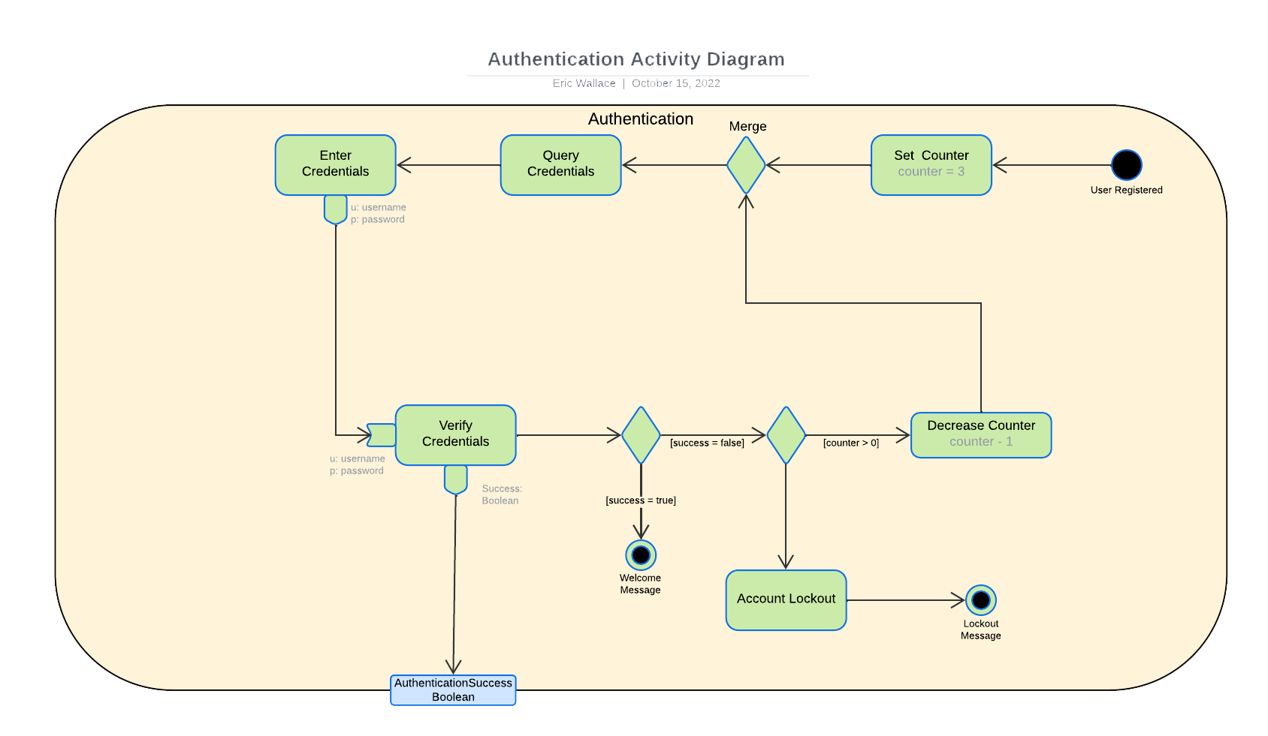
Activity Diagram
Notes:
The process I am using for this diagram is the authentication process, at the start of the process it assumes that a user is registered on the system. The first thing happening is the process is setting the total number of failed attempts a user has to successfully enter the correct password. The next step in the process where two paths are merged into one, after that the system asks the user for their credentials, the user enters their credentials, this step then sends those credentials to the next step which is used to verify the credentials are correct. If the verification is a success the next step will display the welcome message to the user and the user is taken to their dashboard.
If verification was a failure the system checks the counter created in the first step to make sure it is greater than zero, if it is the counter is decreased by one and then the system loops around to ask for user credentials. If the counter is zero then the account is locked and the lockout message is displayed to user.

Slide 5
Security
Account Lockout
Multi-factor authentication
30 minute cooldown period before password can be reset after lockout.
SSL encryption
Role based authorization
0auth2 authentication
Notes:
I considered the items listed above based on current industry standards and guidelines. Knowledge gained from previous security courses allowed me to propose secure methods for logging into the application and measures to prevent unauthorized access to content. My considerations also included the requests made by the client, of the 6 items listed above, 4 of them are directly related to logging in and makes the process of logging in more secure.

Slide 6
System Limitations
Amount of time to develop the system
Additional development team members
Unanswered questions to vital information
User interface constraints
Notes:
From the date in which requirements were collected to the date that is schedule for software deliver is a little bit over 3 months, Feb. 4 – May 10. That is a very short development cycle for an application of this magnitude, take into consideration the second limitation, the need for additional members to the development team will make delivering the software by the deadline very difficult. Next is the need for questions to vital information to be answered, questions such as budget information, which cloud platform the client would like to use for hosting the web application and system resources. Finally, the one thing not discussed is the user interface and another huge limitation on the system design.

